Slide 1
Missing Values

Slide 2
Missing Values
Overview

Slide 3
OVERVIEW
For any data set, it is possible that some of the variables will have missing value.
Some Predictive Modeling techniques can handle missing values. For example:
Decision Trees (CHAID, CART, C4.5)
Gradient Boosting
Random Forests
However, many Predictive Modeling techniques can not handle missing values. For example:
Regression (Linear, Logistic, GLM, etc)
Neural Networks
Support Vector Machines
Any record that has missing values must be addressed prior to utilizing a modeling technique that is unable to handle the missing values.

Slide 4
NAMING MISSING VALUES
Usually, when an analyst imputes (fixes) a missing value, then the analyst will actually create a *NEW* variable with an IMP prefix to show that the variable was imputed. That variable will used in the predictive model.
Another convention is to create a FLAG variable to identify if a variable was imputed or if the value was known.
Sometimes, the fact that a variable was missing can actually be predictive. So the flag might be entered into the predictive model.
For example:
Original Variables:
Y : Target Variable
X : Input Variable (has missing values)
Imputed Variables
Y : Target Variable
X : Input Variable (has missing values)
IMP_X : New Input Variable with all missing values “fixed”
M_X : Flag variable M_X=0 means variable is original 1 means variable imputed.

Slide 5
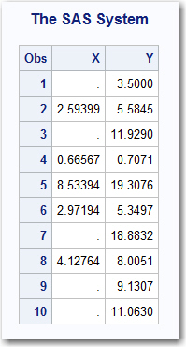
EXAMPLE: NAMING IMPUTE VARIABLES
EXAMPLE: Assume two the data set has two variables, X and Y.
“Y” is the target (“dependent”) variable
“X” is the input (“independent”) variable at that it has missing values.
Results of PROC PRINT of first 10 values show that “X” has missing values
proc print data=ORIGINAL(obs=10);
run;

Slide 6
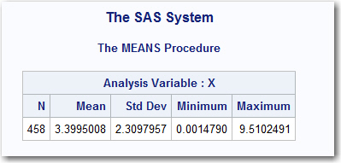
EXAMPLE: NAMING IMPUTE VARIABLES
Assume that the missing “X” values will be imputed with the MEAN value
Results of PROC MEANS for “X” show that the Mean value is approximately 3.4
proc means data=ORIGINAL;
var X;
run;

Slide 7
EXAMPLE: NAMING IMPUTE VARIABLES
This DATA STEP will create a new data set called NEWFILE. The DATA STEP will create two new variables: IMP_X and m_X.
If “X” is NOT missing then
IMP_X = X
M_X = 0
If “X” is missing then
IMP_X = 3.4 (the average value of “X”
M_X = 1
data NEWFILE;
set ORIGINAL;
IMP_X = X;
m_X = 0;
if missing(IMP_X) then do;
IMP_X = 3.4;
m_X = 1;
end;
run;

Slide 8
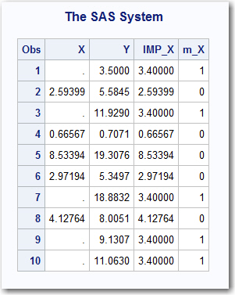
EXAMPLE: NAMING IMPUTE VARIABLES
After the data has been “fixed”, the new data file contains
“Y” is the target (“dependent”) variable
“X” is the input (“independent”) variable at that it has missing values.
“IMP_X” is the “fixed” variable
“m_X” is the flag variable
Results of PROC PRINT of first 10 values show that “X” has missing values
proc print data=NEWFILE(obs=10);
run;

Slide 9
EXAMPLE: NAMING IMPUTE VARIABLES
The imputed “IMP_X” should be used to predict “Y” and “X” should not be used.
The flag variable “m_X” should be included as an input variable into the predictive model because the fact that a variable is missing is often times predictive.
Two different REGRESSION models are generated to predict “Y”
MODEL A: Y is predicted using IMP_X
MODEL B: Y is predicted using IMP_X and M_X
proc reg data=NEWFILE;
A: Model Y = IMP_X;
B: Model Y = IMP_X M_X;
run;
quit;

Slide 10
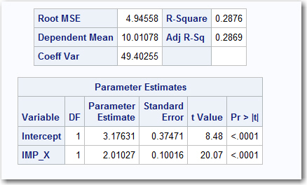
EXAMPLE: NAMING IMPUTE VARIABLES
MODEL: A
Y = IMP_X
Adjusted R2 28.7%

Slide 11
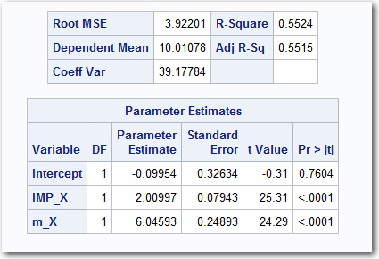
EXAMPLE: NAMING IMPUTE VARIABLES
MODEL: B
Y = IMP_X + m_X
Adjusted R2 55.2%

Slide 12
TECHNIQUES
FIVE METHODS OF DEALING WITH MISSING VALUES:
Delete records with missing values
Avoid using a variable that has a missing value
Use a business rule to fix a missing value
Fill in the missing value with an average value (i.e. Mean, Median, Mode)
Use a decision tree (or similar tool) to build a model to impute the missing value.

Slide 13
EXAMPLE
Assume a marketing company is trying to identify the amount of money a person will pay for a summer vacation. Assume that their data set is called “CUSTOMERS” and contains the following variables.
VACATION : How much the customer spent (in thousands) on last vacation
AGE : Integer value 18 or Older
INCOME : Income in thousands of dollars per year
JOB : Professional, Manager, Labor, Office, Other
YOJ : Integer representing number of years on job
EDUCATION : HighSchool, College, GradSchool
CAR_VALUE : Car value in thousands of dollars
HOME_VALUE : Home value in thousands of dollars
FLAG_CONTACT : Flag indicating customer consents to be contacted 1=YES, 0=NO

Slide 14
EXAMPLE
STEP 1: Explore the data, and see what it looks like.
proc contents data=CUSTOMERS;
run;
proc print data=CUSTOMERS(obs=10);
run;

Slide 15
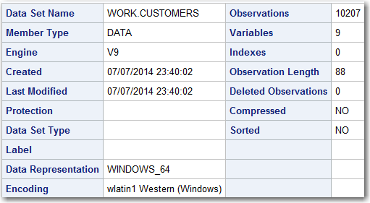
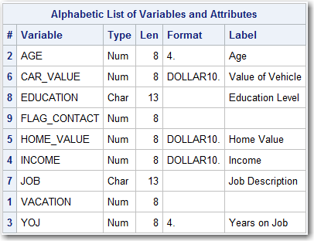
EXAMPLE
STEP 1: Explore the data, and see what it looks like.
proc contents data=CUSTOMERS;
run;
The PROC CONTENTS tells us that there are 10207 records
There are 7 Numeric variables and 2 character variables

Slide 16
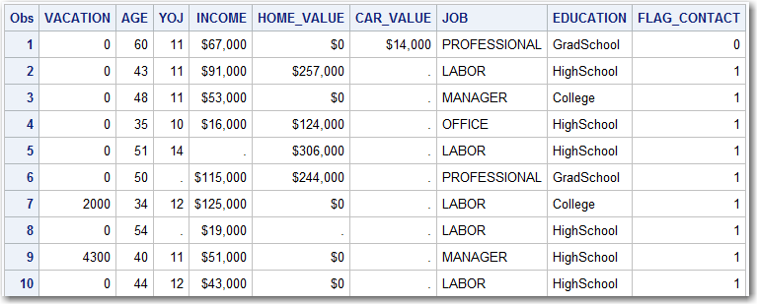
EXAMPLE
STEP 1: Explore the data, and see what it looks like.
proc print data=CUSTOMERS(obs=10);
run;
The PROC PRINT gives a good indication of what the data looks like

Slide 17
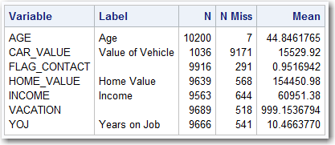
EXAMPLE
STEP 2: Determine if any of the numeric values are missing. The good way to do this is with a PROC MEANS statement. The code and output are given below. The options in the statement are defined as:
n : Number of values not missing
nmiss : Number of values missing
mean : Mean or average of the non-missing values
proc means data=CUSTOMERS n nmiss mean;
var AGE CAR_VALUE FLAG_CONTACT HOME_VALUE INCOME VACATION YOJ;
run;

Slide 18
EXAMPLE
STEP 2: The PROC MEANS results are :
AGE : Average is 44 and there are 7 missing values
CAR_VALUE : Average is $15K and 9171 values (90%) are missing
FLAG_CONTACT : Average is 0.95 and 219 are missing
HOME_VALUE : Average is $154K and 568 are missing
Income : Average is $61K and 644 are missing
VACATION : Average is $999 and 518 are missing
YOJ : Average is 10.5 and 541 are missing

Slide 19
EXAMPLE
STEP 2: The PROC MEANS results are :
AGE : Average is 44 and there are 7 missing values
CAR_VALUE : Average is $15K and 9171 values (90%) are missing
FLAG_CONTACT : Average is 0.95 and 219 are missing
HOME_VALUE : Average is $154K and 568 are missing
Income : Average is $61K and 644 are missing
VACATION : Average is $999 and 518 are missing
YOJ : Average is 10.5 and 541 are missing

Slide 20
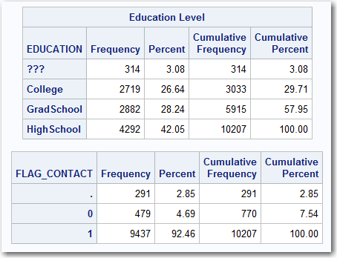
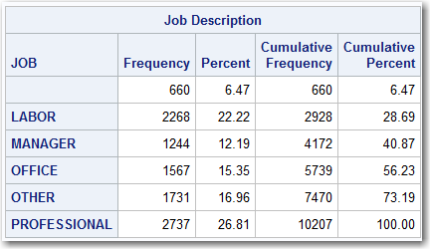
EXAMPLE
STEP 3: Determine if any categorical variables are missing. Note that even though FLAG_CONTACT is numeric, it actually is a categorical variable since it is a 1 or 0 value. The code and results are given below.
proc freq data=CUSTOMERS;
table JOB EDUCATION FLAG_CONTACT /missing;
run;

Slide 21
EXAMPLE
STEP 3:
Job : The most common value is “Professional” and 6.47% are missing
Education : The most common value is “HighSchool” and 3.08% are “???” (missing)
Flag_Content : The most common value is 1 and 2.85% are missing

Slide 22
EXAMPLE
STEP 4: Write a DATA STEP that will be used to create a NEW data set where the missing values are “fixed”. This DATA STEP does nothing more than copy the contents from CUSTOMERS to NEW_CUSTOMERS. After the data step, a PROC PRINT will display the first 15 records of NEW_CUSTOMERS.
data NEW_CUSTOMERS;
set CUSTOMERS;
run;
proc print data=NEW_CUSTOMERS(obs=15);
run;
The result of the PROC PRINT are given in the next slide.

Slide 23
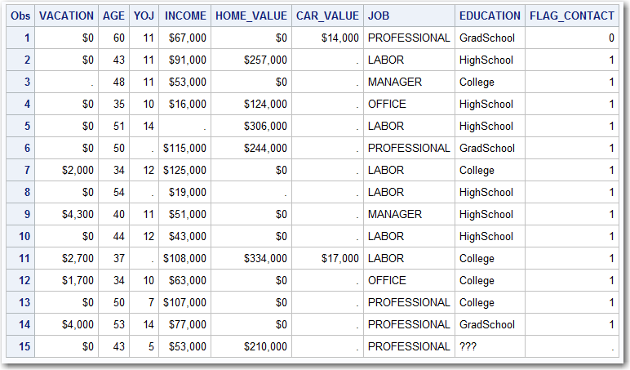
EXAMPLE

Slide 24
EXAMPLE
Method 1: Delete Records that have a missing value
Assume that a business decision was made to delete any record where the target variable (“Vacation”) had a missing value. The code is added to the data step.
data NEW_CUSTOMERS;
set CUSTOMERS;
if missing(VACATION) then delete;
run;
Notice that when the first 15 records are printed, the third record from before is gone. This is because Vacation had a missing value.

Slide 25
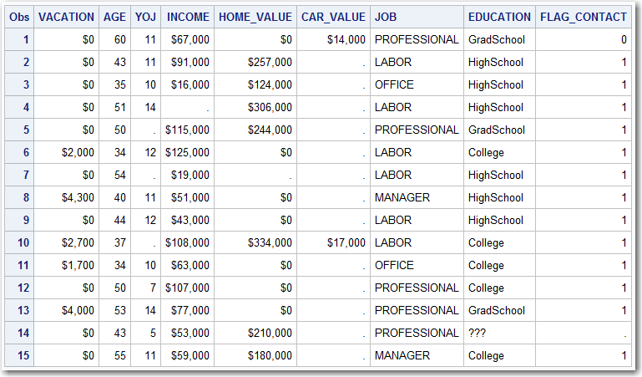
EXAMPLE

Slide 26
EXAMPLE
Method 2: Avoid using variables with missing values
Notice that 90% of the values in the variable “CAR_VALUE” are missing. Because so many values are missing, it was decided not to use that variable and it was dropped from the data set.
data NEW_CUSTOMERS;
set CUSTOMERS;
if missing(VACATION) then delete;
drop CAR_VALUE;
run;
Notice that when the first 15 records are printed, the variable CAR_VALUE is gone.

Slide 27
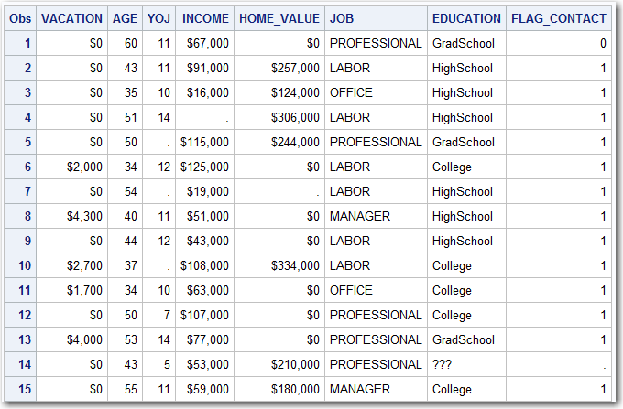
EXAMPLE

Slide 28
EXAMPLE
Method 3: Use a business rule to fix a missing value
The variable “FLAG_CONTACT” indicates that a customer has consented to be contacted regarding product offerings. Most customers have given permission, but assume that a business rule from management requires that missing values be assumed to be “NO PERMISSION”. The missing FLAG_CONTACTS are set to “0” and all the “0” values are then dropped from the data set. The variable FLAG_CONTACT was then dropped from the data set.
data NEW_CUSTOMERS;
set CUSTOMERS;
if missing(VACATION) then delete;
if missing(FLAG_CONTACT) then FLAG_CONTACT = 0;
if FLAG_CONTACT = 0 then delete;
drop FLAG_CONTACT;
drop CAR_VALUE;
run;

Slide 29
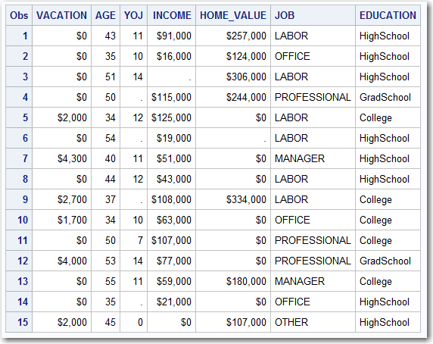
EXAMPLE

Slide 30
EXAMPLE
Method 4: Impute missing values with an average value
The variables AGE, YOJ, and HOME_VALUE will be imputed with their average values. The new variables will be called IMP_AGE, IMP_YOJ, and IMP_HOME_VALUE respectively. Also, two new variables were created: M_YOJ and M_HOME_VALUE. If either value was missing and imputed, then the respective variable would be set to 1, otherwise it would be 0. This was not done for “AGE” because only 7 values were missing, so there did not seem to be a reason to create a variable.
The original variables will be dropped from the data set for convenience, but this is not required.

Slide 31
EXAMPLE
data NEW_CUSTOMERS;
set CUSTOMERS;
if missing(VACATION) then delete;
IMP_AGE = AGE;
if missing(AGE) then IMP_AGE = 44.9;
drop AGE;
IMP_YOJ = YOJ;
M_YOJ = 0;
if missing(YOJ) then do;
IMP_YOJ = 10.5;
M_YOJ = 1;
end;
drop YOJ;
IMP_HOME_VALUE = HOME_VALUE;
M_HOME_VALUE = 0;
if missing(HOME_VALUE) then do;
IMP_HOME_VALUE = 154000;
M_HOME_VALUE = 1;
end;
drop HOME_VALUE;
if missing(FLAG_CONTACT) then FLAG_CONTACT = 0;
if FLAG_CONTACT = 0 then delete;
drop FLAG_CONTACT;
drop CAR_VALUE;
run;

Slide 32
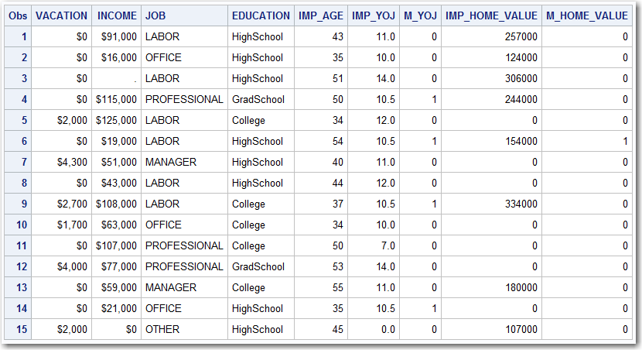
EXAMPLE

Slide 33
EXAMPLE
Method 4: Impute missing values with an average value
The variables JOB and EDUCATION will be imputed with their most common values (Mode). As with AGE and YOJ, the imputed variables will be called IMP_JOB and IMP_EDUCATION. Also, flag variables will be created to indicate if a variable has been imputed.
The original variables will be dropped from the data set for convenience, but this is not required.

Slide 34
EXAMPLE
data NEW_CUSTOMERS;
set CUSTOMERS;
if missing(VACATION) then delete;
IMP_JOB = JOB;
M_JOB = 0;
if missing(JOB) then do;
IMP_JOB = "PROFESSIONAL";
M_JOB = 1;
end;
drop JOB;
IMP_EDUCATION = EDUCATION;
M_EDUCATION = 0;
if EDUCATION in ("???") then do;
IMP_EDUCATION = "HighSchool";
M_EDUCATION = 1;
end;
drop EDUCATION;
IMP_AGE = AGE;
if missing(AGE) then IMP_AGE = 44.9;
drop AGE;
IMP_YOJ = YOJ; M_YOJ = 0;
if missing(YOJ) then do; IMP_YOJ = 10.5; M_YOJ = 1;end;
drop YOJ;
IMP_HOME_VALUE = HOME_VALUE; M_HOME_VALUE = 0;
if missing(HOME_VALUE) then do; IMP_HOME_VALUE = 154000; M_HOME_VALUE = 1; end;
drop HOME_VALUE;
if missing(FLAG_CONTACT) then FLAG_CONTACT = 0;
if FLAG_CONTACT = 0 then delete;
drop FLAG_CONTACT;
drop CAR_VALUE;
run;

Slide 35
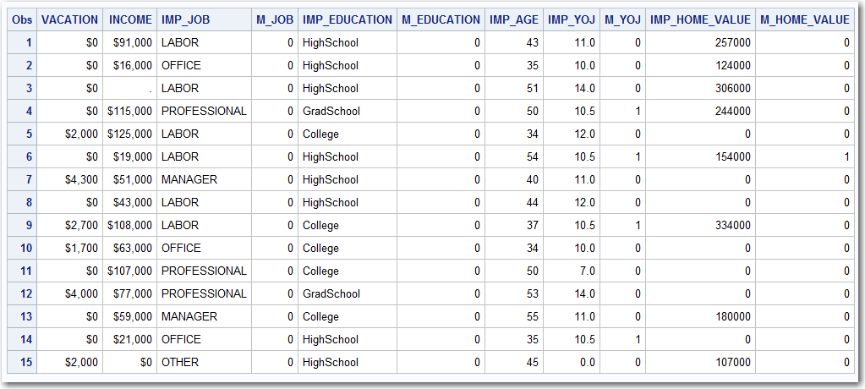
EXAMPLE

Slide 36
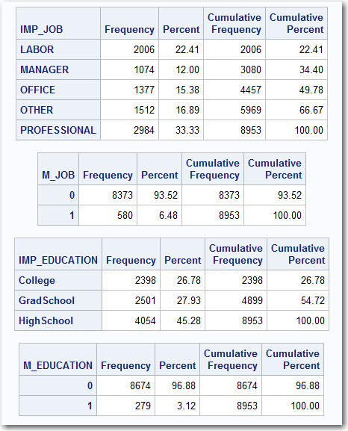
EXAMPLE

Slide 37
EXAMPLE
Method 5: Use a decision tree to build a model to impute the missing value.
For the INCOME variable, a simple decision tree was used to predict the value of INCOME based upon the other variables in the data set.
The decision tree is presented on the following slide
The rules from the decision tree are presented on the next slide

Slide 38
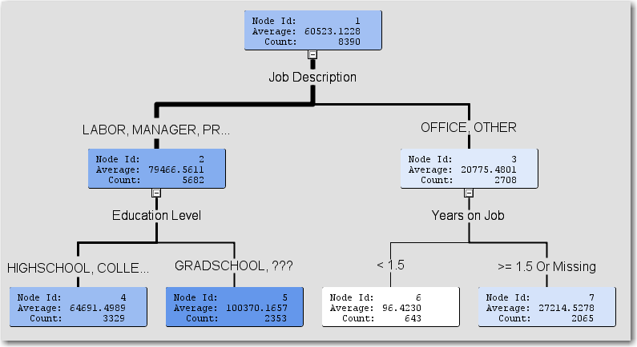
EXAMPLE

Slide 39
EXAMPLE
if Job Description IS ONE OF: LABOR, MANAGER, PROFESSIONAL or MISSING
AND Education Level IS ONE OF: HIGHSCHOOL, COLLEGE or MISSING
then Predicted: INCOME = 64691.498949
if Job Description IS ONE OF: LABOR, MANAGER, PROFESSIONAL or MISSING
AND Education Level IS ONE OF: GRADSCHOOL, ???
then Predicted: INCOME = 100370.16575
if Years on Job < 1.5
AND Job Description IS ONE OF: OFFICE, OTHER
then Predicted: INCOME = 96.423017107
if Years on Job >= 1.5 or MISSING
AND Job Description IS ONE OF: OFFICE, OTHER
then Predicted: INCOME = 27214.527845

Slide 40
EXAMPLE
data NEW_CUSTOMERS;
set CUSTOMERS;
if missing(VACATION) then delete;
IMP_INCOME = INCOME;
M_INCOME = 0;
if missing(IMP_INCOME) then do;
M_INCOME = 1;
if JOB in ("OFFICE","OTHER") then do;
if YOJ >= 1.5 or missing(YOJ) then IMP_INCOME = 27215; else IMP_INCOME = 96;
end;
else do;
if EDUCATION in ("GRADSCHOOL","???") then IMP_INCOME = 100370; else IMP_INCOME = 64691;
end;
end;
drop INCOME;
IMP_JOB = JOB; M_JOB = 0;
if missing(JOB) then do; IMP_JOB = "PROFESSIONAL"; M_JOB = 1; end;
drop JOB;
IMP_EDUCATION = EDUCATION; M_EDUCATION = 0;
if EDUCATION in ("???") then do; IMP_EDUCATION = "HighSchool"; M_EDUCATION = 1; end;
drop EDUCATION;
IMP_AGE = AGE; if missing(AGE) then IMP_AGE = 44.9; drop AGE;
IMP_YOJ = YOJ; M_YOJ = 0;
if missing(YOJ) then do; IMP_YOJ = 10.5; M_YOJ = 1; end;
drop YOJ;
IMP_HOME_VALUE = HOME_VALUE; M_HOME_VALUE = 0;
if missing(HOME_VALUE) then do; IMP_HOME_VALUE = 154000; M_HOME_VALUE = 1; end;
drop HOME_VALUE;
if missing(FLAG_CONTACT) then FLAG_CONTACT = 0;
if FLAG_CONTACT = 0 then delete;
drop FLAG_CONTACT;
drop CAR_VALUE;
run;

Slide 41
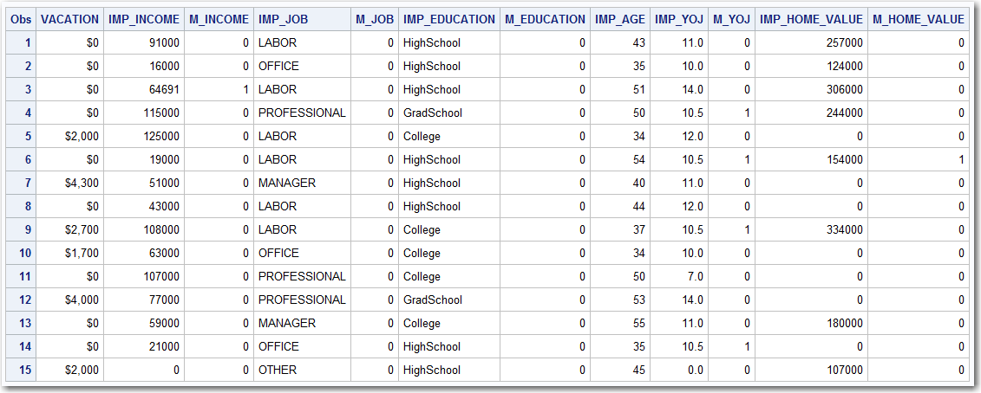
EXAMPLE

